Slide 1
6CS005 High Performance Computing
Lecture 4 Multi-Programming

Slide 2
Review of Last Week's Content
Parallel Computing Overview
Key Components of Parallel Computing
Serial and Parallel Computing
Sequential and Parallel Programming
Relationship Between Tasks
Classification of Computing Systems: Flynn’s Classification
Enhancing Computational Efficiency: Key Objectives
Classification of Computer Architecture by Memory Organization
Homogeneous Computing
Homogeneous Architecture
Program, process, and Threads
Context Switch
Process States
Critical Section, Mutual Exclusion

Slide 3
Multiprogramming
Multiprogramming is an approach in operating systems where multiple programs (or processes) are loaded into memory and allowed to execute concurrently.
It maximize CPU utilization by having the CPU work on another program when one is waiting for I/O.
Without multiprogramming, the CPU would be idle whereas multiprogramming keeps the CPU busy.

Slide 4
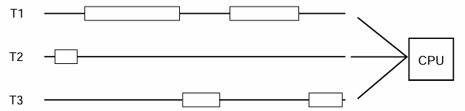
Contd…
Multiprogramming enables concurrency by allowing multiple programs to share CPU time through context switching.

Slide 5
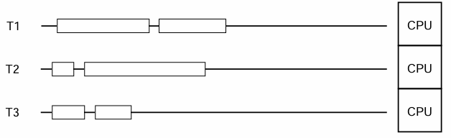
Contd…
Multiprogramming can achieve parallelism if it runs on a multicore processor, where different programs execute on separate cores simultaneously.

Slide 6
Concurrency and Parallelism
Three Main types of concurrent or parallel programming systems
  Multitasking (Concurrent Processing) – Handling multiple tasks or processes concurrently.
  Multithreading – Running multiple threads within a single process.
  Distributed Computing – Executing tasks across multiple machines

Slide 7
Multitasking
Multitasking is running multiple programs at the same time a single operating system.
On a single-core CPU computer, only one task/program is running at any one time on the CPU.
At predetermined intervals, the operating system pauses the current task, saves its state and loads another task into the CPU an runs it.
This is called context-switching.

Slide 8
Multithreading
Multithreading is the parallel execution of multiple instances of your program's code, within the same process.
Multithreading is similar to multitasking except that all the running programs(threads) share same the same memory, the same variables and everything else in the program.
The individual threads can have either little or high interactions with each other.

Slide 9
Multithreading
Modern processor have more than one CPU core: up to AMD Ryzen Threadripper 3990X 64-Core, 128-Thread
The Nvidia H100 Core has 16896 CUDA cores.
Single-threaded programs can only use 1 core at a time.
Multi-threaded programs can spread the processing load across all the cores available.
For example an image processing program can divide up an image into 16 equal parts and process each parts using a separate thread, and this will run up to 16 times faster than a single-thread program

Slide 10
Why not Multithreading Everywhere?
It is not always possible to break a problem down into separate equal parts, for example, processing a file that is received over the network, one character at a time.
It is sometimes difficult to organise and manage the work divided between threads efficiently:
  Imagine a fast food kitchen with multiple cooks looking at the same items from a large order screen. Who cooks what when?
When the timing of a process is critical, eg. flight controller software, multithreading can introduce uncertainties or challenges.

Slide 11
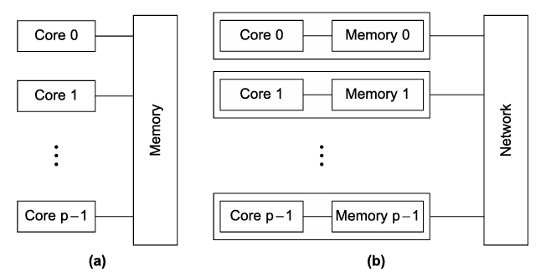
Distributed Computing
Very similar to multitasking, except that the processes can potentially be running on separate computers on a network.
Relies on network messages to interact and exchange data between processes.
Generally requires a standardized system or framework to operate: e.g. Actor, Message Passing Interface.

Slide 12
Programing API’s
Our purpose is to learn the basics of programming parallel computers using the C language and four different APIs or application program interfaces: the Message-Passing Interface or MPI, POSIX threads or Pthreads, OpenMP, and CUDA.
Different API’s are used for programming different types of systems:
  MPI is an API for programming distributed memory MIMD systems.
  Pthreads is an API for programming shared memory MIMD systems.
  OpenMP is an API for programming both shared memory MIMD and shared memory SIMD systems, although we’ll be focusing on programming MIMD sys tems.
  CUDA is an API for programming Nvidia GPUs, which have aspects of all four classifications such as: shared memory and distributed memory, SIMD, and MIMD.

Slide 13
How to use threading in C (Pthread)?
The POSIX "Portable Operating System Interface." Threads standard is the most widely used threading API, also known as pthreads.
To use pthreads, you have include the header file <pthread.h>
To create and start a thread, you have to call the API pthread_create()
To wait for a thread to finish, you have to call the API pthread_join()
To End and return results from a thread, you have to call the API pthread_exit()

Slide 14
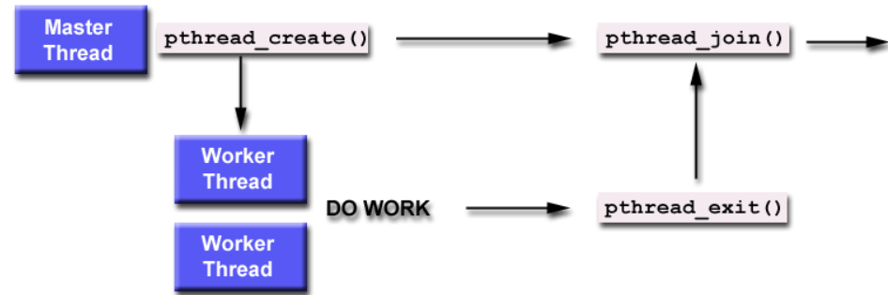
Joining Threads
Joining is one way to accomplish synchronization between the threads.

Slide 15
Pthreads Example
#include <pthread.h>
#include <stdio.h>
void *threadOne(void *p){
for(int i=0; i<1000; i++)
printf("Thread One: i=%d\n",i);
}
void *threadTwo(void *p){
for(int i=0; i<1000; i++)
printf("Thread Two: i=%d\n",i);
}
void main(){
pthread_t thrID1, thrID2;
pthread_create(&thrID1, NULL, threadOne, NULL);
pthread_create(&thrID2, NULL, threadTwo, NULL);
pthread_join(thrID1, NULL);
pthread_join(thrID2, NULL);
}

Slide 16
Converting Single Thread to Multithreaded
#include <stdio.h>
void main()
{
int i, c;
int nstart=1, nfinish=20000;
printf("Prime numbers between %d and %d are :\n", nstart, nfinish);
for(i=nstart; i<=nfinish; i++){
for(c = 2; c <= i-1; c++){
if ( i%c == 0 )
break;
}
if ( c == i )
printf("%d\n", i);
}
}

Slide 17
Multithreaded Version - 2 threads
#include <stdio.h>
#include <pthread.h>
void *threadOne(void *p){
int i, c;
int nstart=1, nfinish=10000;
for(i=nstart; i<=nfinish; i++){
for(c=2; c <= i-1; c++){
if ( i%c == 0 )
break;
}
if ( c == i )
printf("threadOne : %d\n", i);
}
return 0;
}
void main(){
pthread_t thrID1, thrID2;
printf("threadOne : Prime numbers between %d and %d are :\n", nstart, nfinish);
pthread_create(&thrID1, NULL, threadOne, NULL);
pthread_create(&thrID2, NULL, threadTwo, NULL);
pthread_join(thrID1, NULL);
pthread_join(thrID2, NULL);
}
void *threadTwo(void *p){
int i, c;
int nstart=10001, nfinish=20000;
for(i=nstart; i<=nfinish; i++){
for(c=2; c<=i-1; c++){
if ( i%c==0 )
break;
}
if ( c==i )
printf("threadTwo : %d\n", i);
}
return 0;
}

Slide 18
Any-Threaded Version
void main(int argc, char **argv){
int numThreads = 0;
int i;
pthread_t thrID[100];
struct threadArgs targs[100];
if ( argc > 1 ) {
numThreads = atoi(argv[1]);
}
if (numThreads > 0 && numThreads <= 100){
int chunksize = 10000/numThreads ;
for (i=0; i < numThreads; i++){
targs[i].start = i * chunksize;
targs[i].finish = (i * chunksize) + chunksize;
pthread_create(&thrID[i], NULL, threadMain, &targs[i]);
}
for (i=0; i < numThreads; i++){
pthread_join(thrID[i], NULL);
}
}
}
#include <stdio.h>
#include <pthread.h>
#include <stdlib.h>
struct threadArgs {
int start;
int finish;
};
void *threadMain(void *p){
struct threadArgs *pargs = p;
int i, c;
int nstart=pargs->start, nfinish=pargs->finish;
pthread_t tid = pthread_self();
for(i=nstart; i<=nfinish; i++){
for(c=2; c<=i-1; c++) {
if ( i%c==0 )
break;
}
if ( c==i )
printf("Thread %ld : %d\n",tid, i);
}
return 0;
}

Slide 19
pthread_create()
int pthread_create(
pthread_t *threadID,
pthread_attr_t *attr,
void *(*thread_function) (void *),
void *targ);
Creates a thread and executes thread_function
threadID - pointer to a thread ID variable to identify the thread after it has been created.
attr - thread attributes - normally NULL;
thread_function - the main thread function.
targ - pointer to the parameter. Can be NULL;
On success, pthread_create() returns 0; on error, it returns an error number

Slide 20
pthread_join()
int pthread_join(pthread_t threadID,
void **retval);
Waits for the thread with threadID to finish.
threadID - the id of the thread specified by pthread_create()
retval - a thread can return a value via the function pthread_exit(). retval is a pointer to the return value.
On success, pthread_join() returns 0; on error, it returns an error number.

Slide 21
Ending and returning results from a thread
void pthread_exit(void *retval)
  This function terminates the calling thread and returns a value via the location pointed to by retval.
  retval must point to a valid memory location when the calling thread terminates.
  retval must not point to a local thread variable.

Slide 22
pthread_exit()
#include <pthread.h>
#include <stdio.h>
char retval[] = "Hello there!";
void *threadOne(void *p){
pthread_exit(retval);
}
void main(){
void *pretval1;
pthread_t thrID1;
pthread_create(&thrID1, NULL, threadOne, NULL);
pthread_join(thrID1, &pretval1);
printf("*pretval1 = %s\n", (char *)pretval1);
}

Slide 23
Returning an int value
int gretval=0;
void *threadOne(void *p){
gretval = 42;
pthread_exit(&gretval);
}
void main(){
void *pretval1;
int retval;
pthread_t thrID1;
pthread_create(&thrID1, NULL, threadOne, NULL);
pthread_join(thrID1, &pretval1);
retval=*(int *)pretval1;
printf("*pretval1 = %d\n", retval);
}

Slide 24
Return dynamic memory
void *threadOne(void *p){
char *retval;
retval= malloc(1000);
strcpy(retval, "Hello world!");
pthread_exit(retval);
}
void main(){
void *pretval;
pthread_t thrID1;
pthread_create(&thrID1, NULL, threadOne, NULL);
pthread_join(thrID1, &pretval);
printf("*pretval = %s\n", (char *)pretval);
free(pretval);
}

Slide 25
Return dynamic memory
void *threadOne(void *p){
int *retval;
retval= malloc(sizeof(int));
*retval = 42;
pthread_exit(retval);
}
void main(){
void *pretval;
int retval;
pthread_t thrID1;
pthread_create(&thrID1, NULL, threadOne, NULL);
pthread_join(thrID1, &pretval);
retval=*(int *)pretval;
printf("retval = %d\n", retval);
}

Slide 26
Return a string
int main() {
void *pretval1;
pthread_t thrID1;
// Create the thread
pthread_create(&thrID1, NULL, threadOne, NULL);
// Wait for the thread to finish and retrieve the return value
pthread_join(thrID1, &pretval1);
// Print the returned string
printf("Returned string: %s\n", (char *)pretval1);
// Free the allocated memory
free(pretval1);
return 0;
}
void *threadOne(void *p) {
// Allocate memory for the string to be returned
char *retval = malloc(20 * sizeof(char));
if (retval == NULL) {
perror("malloc failed");
pthread_exit(NULL);
}
// Copy the string into the allocated memory
strcpy(retval, "Hello from thread");
// Exit the thread, returning the string
pthread_exit(retval);
}

Slide 27
Cancelling a running thread
int pthread_cancel(pthread_t thread)
  This function sends a cancellation request to the specified thread.
  The thread can be canceled at any time, usually immediately, but this is not guaranteed

Slide 28
Cancelling a running thread
#include <pthread.h>
#include <stdio.h>
#include <unistd.h>
void *threadFunc(void *p){
long i;
for(i = 0; i <10000000; i++){
printf("i = %ld\n", i);
}
}
void main(){
pthread_t thrID;
pthread_create(&thrID, NULL, threadFunc, NULL);
sleep(1);
pthread_cancel(thrID);
pthread_join(thrID, NULL);
}

Slide 29
Semaphore functions
int sem_init (sem_t *sem, int pshared, unsigned int value)
  sem_init initializes the semaphore. The pshared indicates whether the semaphore is local to the current process (0) or is to be shared between several processes (not zero)., The value is the initial count value of the semaphore. Value parameter depends on Binary semaphore(1-Locked, 0-Unlocked) and Counting Semaphore(3)
int sem_destroy (sem_t * sem)
  sem_destroy frees the resources held by the semaphore..
int sem_wait (sem_t * sem)
  sem_wait suspends the calling thread until the semaphore pointed to by sem has non-zero count. It then decreases the semaphore count.
int sem_post (sem_t * sem)
  sem_post increases the count of the semaphore pointed to by sem. This function never blocks.

Slide 30
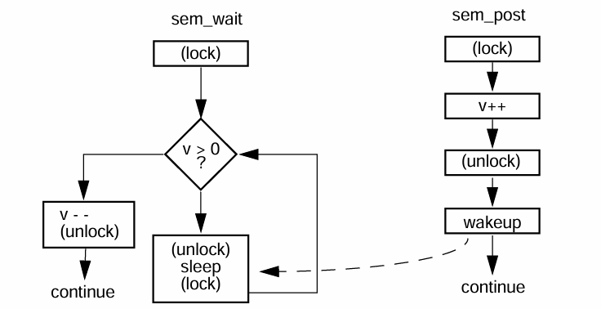
Flowchart for Semaphores

Slide 31
Simple Semaphore example
#include <stdio.h>
#include <pthread.h>
#include <unistd.h>
#include <semaphore.h>
sem_t semaBooks;
int booksAvailable = 3;
void *borrower(void *p)
{
for(int i = 0; i<=10; i++){
printf("Borrower %d wants to borrow a book. ",(int)p);
printf("Books available = %d\n",booksAvailable);
sem_wait(&semaBooks); //Borrowing a book
printf("Borrower %d gets a book. ", (int)p);
booksAvailable--;
printf("Books available = %d\n",booksAvailable);
usleep(10000); //reading book
printf("Borrower %d is returning a book. ", (int)p);
booksAvailable++;
printf("Books available = %d\n",booksAvailable);
sem_post(&semaBooks); //Returning a book
}
return NULL;
}
void main()
{
pthread_t thrID1, thrID2, thrID3;
pthread_t thrID4, thrID5, thrID6;
sem_init(&semaBooks, 0, 3 );
pthread_create(&thrID1, NULL, borrower, (void *)1);
pthread_create(&thrID2, NULL, borrower, (void *)2);
pthread_create(&thrID3, NULL, borrower, (void *)3);
pthread_create(&thrID4, NULL, borrower, (void *)4);
pthread_create(&thrID5, NULL, borrower, (void *)5);
pthread_create(&thrID6, NULL, borrower, (void *)6);
pthread_join(thrID1, NULL);
pthread_join(thrID2, NULL);
pthread_join(thrID3, NULL);
pthread_join(thrID4, NULL);
pthread_join(thrID5, NULL);
pthread_join(thrID6, NULL);
sem_destroy(&semaBooks);
}

Slide 32

Critical Sections
When multiple threads share global resources, they may interfere with each other
We need a protection mechanism to prevent this interference
Critical section - section of code that need this protection

Slide 33
Thread interference
int counter=0;
void *threadOne(void *p)
{
for(int i=0; i<1000; i++){
counter =
doSomething(counter);
}
}
void *threadTwo(void *p)
{
for(int i=0; i<1000; i++){
counter =
doSomething(counter);
}
}
void main()
{
pthread_t thrID1, thrID2;
pthread_create(&thrID1, NULL,
threadOne, NULL);
pthread_create(&thrID2, NULL,
threadTwo, NULL);
pthread_join(thrID1, NULL);
pthread_join(thrID2, NULL);
printf("Final counter = %d\n",
counter);
}

Slide 34
Critical Section
The critical section that needs to be protected in this code is this bit in both threads:
for(int i=0; i<1000; i++){
counter = doSomething(counter);
}

Slide 35
Protecting Critical Sections
The critical section is protected by mutex:
for(int i=0; i<100; i++){
pthread_mutex_lock(&mutex);
counter = doSomething(counter);
pthread_mutex_unlock(&mutex);
}

Slide 36
Pthread Mutex Functions
pthread_mutex_init (mutex,attr)
  Initialises the mutex, "attr" is optional,; should be set to NULL
pthread_mutex_destroy (mutex)
  Frees the resources used by the mutex
pthread_mutex_lock (mutex)
  Locks the mutex. If the mutex is already locked by another thread, it will wait, until it acquires the lock
pthread_mutex_unlock (mutex)
  Unlocks the mutex. If another thread is waiting to lock the mutex, the lock will be transfered to the waiting thread.
pthread_mutex_t
  This is the mutex datatype.

Slide 37
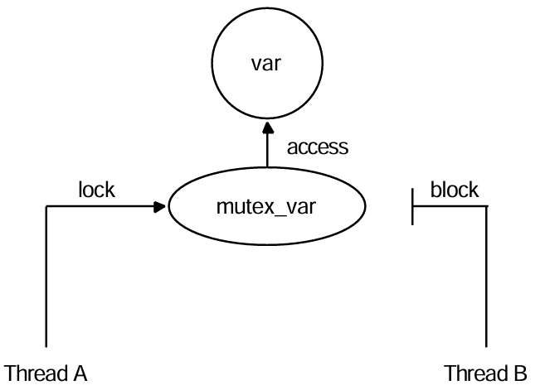
Only one thread can lock a Mutex

Slide 38
Deadlocks
With mutexes, there is the possibility of deadlocks.
This is when all the threads are waiting for different mutexes which are locked by other threads. E.g.:
  Thread A locks Mutex 1
  Thread B locks Mutex 2
  Thread A attempts to lock Mutex 2
  Thread B attempts to lock Mutex 1
  Deadlock!

Slide 39
Avoiding deadlocks
pthread_mutex_trylock (mutex)
  pthread_mutex_trylock() will attempt to lock a mutex.
  However, if the mutex is already locked, the routine will return immediately with a non-zero error code.
  This may be useful in preventing deadlock conditions
  A deadlock is a situation in concurrent programming or multitasking where two or more threads or processes become stuck in a way that none of them can proceed with their execution.

Slide 40
Mutex Vs. Semaphores
Mutexes allow only one thread to enter a critical section at a time.
This can have a significant performance impact when there are lots of threads
Semaphores are an alternative method of synchronizing multiple threads
This can allow multiple threads to access a "pool" of resources at the same time without interfering with each other.

Slide 41
End of Lecture 4

